Slide 1
有効的更新
Effective Transformation
雅各書 1:19-27

Slide 2
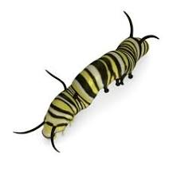

Slide 4
重生
稱義----------------- 成聖 -------------- 得榮耀
有効的更新

Slide 5
我們對神的真道
應該如何有効的
反應？

Slide 6
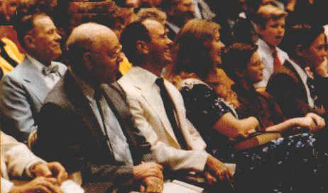
有効的聽道 有効的行道

Slide 7
如何有効的聽道
雅各書 1:19，21
19 我親愛的弟兄們，這是你們所知道的。但你們各人要快快地聽，慢慢地說，慢慢地動怒 21 所以，你們要脫去一切的污穢和盈餘的邪惡，存溫柔的心領受那所栽種的道，就是能救你們靈魂的道
19 Know this, my beloved brothers: let every person be quick to hear, slow to speak, slow to anger; 21 Therefore put away all filthiness and rampant wickedness and receive with meekness the implanted word, which is able to save your souls.

Slide 8
如何有効的聽道
要快快的聽

Slide 9
如何有効的聽道
要快快的聽
聽的時候要慢慢地說

Slide 10
如何有効的聽道
要快快的聽 。be swift to hear;
聽的時候要慢慢地說。slow to speak
聽的時候要慢慢地動怒。 slow to wrath

Slide 12
Eph4:26-27
26 生氣卻不要犯罪；不可含怒到日落
27 不要給 魔鬼留地歩。
26 Be angry and do not sin; do not let the sun
go down on your anger, 27 and give no opportunity
to the devil.

Slide 13
如何有効的聽道
要快快的聽 。be swift to hear;
聽的時候要慢慢地說。slow to speak
聽的時候要慢慢地動怒。 slow to wrath
存溫柔的心聽。receive with meekness

Slide 14
雅各 1:21
21 所以，你們要脫去一切的污穢和盈餘的邪惡，存溫柔的心領受那所栽種的道，就是能救你們靈魂的道
Therefore，put away all filthiness and rampant wickedness and receive with meekness the implanted word, which is able to save your souls.

Slide 15
如何有効的行道
不要欺哄自己
22 只是你們要行道，不要單單聽道，自己欺哄自己
“But be doers of the word and not hearers only, deceiving yourselves

Slide 16
如何有効的行道
不要欺哄自己
以神的話語詳細察看自己
23 因為聽道而不行道的，就像人對著鏡子看自己本來的面目， 24 看見，走後，隨即忘了他的相貌如何
23 For if anyone is a hearer of the word and not a doer, he is like a man who looks intently at his natural face in a mirror. 24 For he looks at himself and goes away and at once forgets what he was like.

Slide 17
如何有効的行道
不要欺哄自己
以神的話語詳細察看自己
採取實際的行動

